Slide 1
CLUSTER COMPUTING

Slide 2
OVERVIEW
History
Introduction
Types of cluster
Components of cluster
Advantage
Disadvantages
Application
CONCLUSION
References

Slide 3
HISTORY
Greg Pfister is a computer scientist and worked a lot for cluster computing, according to him clusters were not invented by any specific vendor but by customers.
The first commodity clustering product was ARC net(Attached Resource Computer Network), developed by Datapoint in 1977.
The next product was VAX cluster , released by DEC in 1980’s.
Microsoft, sun microsystems, and other leading hardware and software companies offer clustering packages.

Slide 4
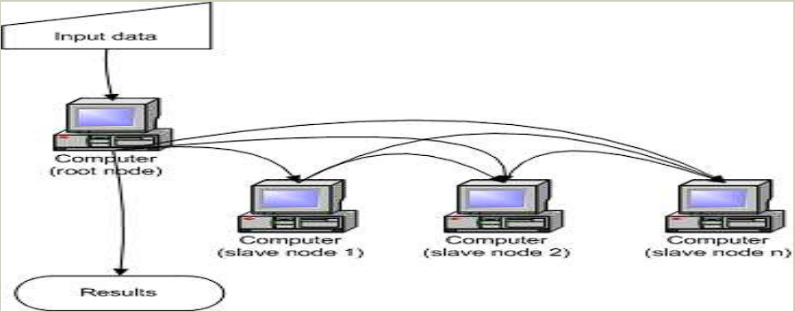
CLUSTER COMPUTING
Cluster computing is a parallel or distributed computer system, which is a collection of inter-connected stand-alone computers working together as a single integrated computing resource.
Clusters are commonly connected through fast local area networks.

Slide 5
WHY CLUSTER COMPUTING?
Improve Speed
Closer Connection.
Cost effective
Low latency communication Protocols.
Loosely coupled.

Slide 6
TYPES OF CLUSTER
High performance clusters
High availability cluster or Failover Clusters
Load balancing cluster

Slide 7
HIGH PERFORMANCE CLUSTER
Start from 1994
High Performance clusters use computer clusters and supercomputers to solve advance computational problems.
They are used to performing functions that need nodes to communicate as they perform their jobs.
They are designed to take benefit of the parallel processing power of several nodes.

Slide 8
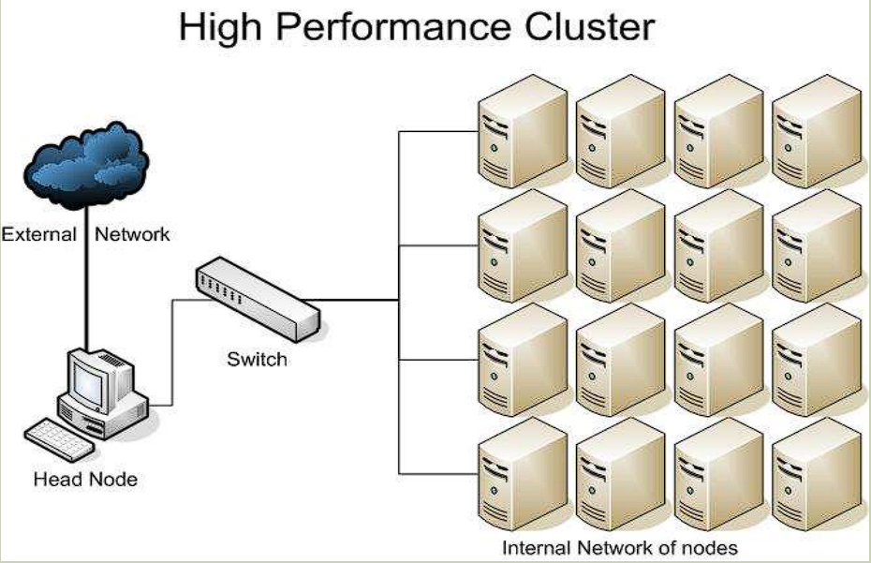

Slide 9
HIGH AVAILABILITY CLUSTERS OR FAILOVER CLUSTERS
Avoid single point of failure.
This requires at least two nodes a primary and a backup.
Always with redundancy.
Almost all load balancing cluster are with HA capability.
Used to implement database, mail, file print, web application servers.

Slide 10
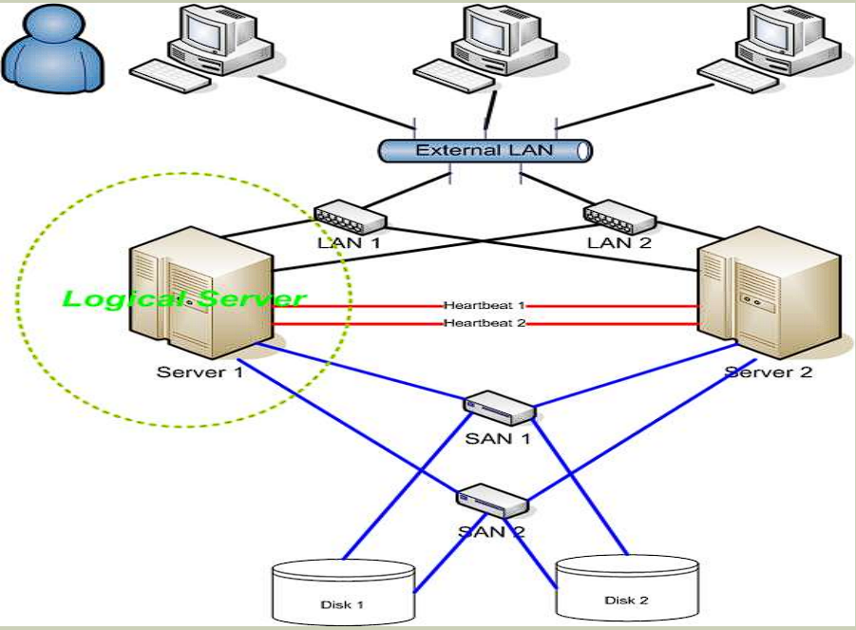
HIGH AVAILABILITY CLUSTERS OR FAILOVER CLUSTERS

Slide 11
LOAD BALANCING CLUSTER
Pc cluster deliver load balancing performance.
It distributes incoming requests for resources or content among multiple nodes running the same programs or having the same content
Each node in cluster is able to handle requests for the same content or application.
Both the high availability and load balancing cluster technologies can be combined to increase the reliability, availability , and scalability of application and data resources that are widely deployed for web , mail or FTP services.

Slide 12
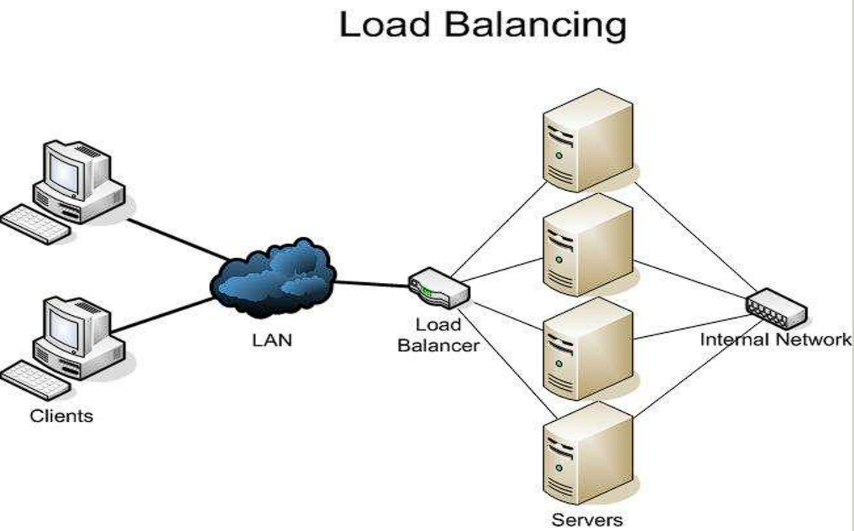

Slide 13
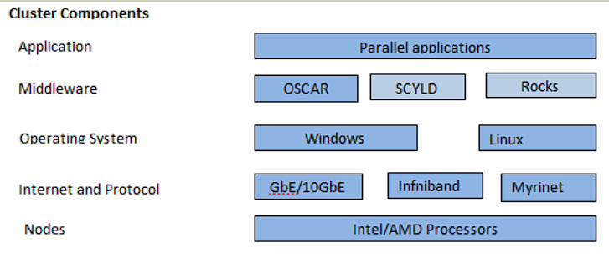
COMPONENTS OF CLUSTER
The basic building blocks of clusters are broken down into multiple categories:
The cluster nodes,
Cluster operating system,
Network switching hardware and
The node/switch interconnect

Slide 14
ADVANTAGES
Availability
In case if server is having a problem another server from the cluster takes over the server having issue. This ensure the high availability of web applications.
Load Handling and maintenance
If a dedicated server from the cluster requires maintenance , it can be stopped while other servers handles.
Easy to manage
More easy cluster management software are emerging to manage the clusters and in present also some are available.

Slide 15
DISADVANTAGES
More Space is required
Server clustering usually requires more servers and hardware to manage and monitor thus increases the infrastructure. Some web hosting providers may afford it.
Very expensive
It is not a cost-effective solution, as it needs a good server design which can be a bit expensive.

Slide 16
APPLICATIONS
Web serving/searching (google search engine)
Email , e-chat , e-book, e-bank
E-commerce application(amazon.com, ebay.com)

Slide 17
CONCLUSION
Cluster computing has become a major part of many research program because the price to performance ratio of commodity cluster is very good. Also, because the nodes in a cluster are clone, there is no single point of failure, which enhances the reliability to the cluster.

Slide 18
References
https://www.w3schools.com/
https://www.freepik.com/
https://www.youtube.com/
https://www.javatpoint.com/

Slide 19
THANK You

